Slide 1

DATA ANALYSIS OF JOB INDUSTRIES
ST0248 PDS DIT2B32
Name: Victoria Chee
Student ID: 1747306
FOR IT STUDENTS’ CONSIDERATION

Slide 2
BACKGROUND
THE STORY BEHIND THE PROJECT
This data analysis project aims to help students in the IT diploma course (or other courses) figure out what industry they want to do their future studies in and work in, in the near future.
Some students may be considering trying out a whole new field, or may be hesitant to stay in Information Technology.
Through analysis of the available fields, students can make a more informed decision on what fields they want to go into next.

Slide 3

DATASETS
Nature of Data sets

Slide 4
Data sets used
Chart Type | Chart | Dataset | Dataset URL
Scatter | Monthly Salary against Employment Rate for each University Industry | Graduate Employment Survey - NTU, NUS, SIT, SMU & SUTD | https://data.gov.sg/dataset/graduate-employment-survey-ntu-nus-sit-smu-sutd
Boxplot | Monthly Salary for each Industry | Graduate Employment Survey - NTU, NUS, SIT, SMU & SUTD | https://data.gov.sg/dataset/graduate-employment-survey-ntu-nus-sit-smu-sutd
Line graph | Annual Salary for each Workforce Industry from 1980 to 2016 | Compensation Of Employees By Industry At Current Prices, Annual | https://data.gov.sg/dataset/compensation-of-employees-by-industry-at-current-prices-annual
Histogram | Frequency of Job Vacancies for each Workforce Industry | Job Vacancy by Industry and Occupational Group, Quarterly | https://data.gov.sg/dataset/job-vacancy-by-industry-and-occupational-group-quarterly
Line graph | Job Vacancies against Year from 1990 to 2016 | Job Vacancy by Industry and Occupational Group, Quarterly | https://data.gov.sg/dataset/job-vacancy-by-industry-and-occupational-group-quarterly
Bar chart | Highest paid/Most Common Occupations in Info Tech Industry | Data USA - Yearly Income for Common Jobs for Information Technology Majors-1 | https://datausa.io/profile/cip/110103/#locationshttps://datausa.io/profile/cip/110103/#locations
Bar chart | Lowest paid/Least Common Occupations in Info Tech Industry | Data USA - Yearly Income for Common Jobs for Information Technology Majors-1 | https://datausa.io/profile/cip/110103/#locationshttps://datausa.io/profile/cip/110103/#locations

Slide 5
DATASET 1 : Graduate Employment Survey - NTU, NUS, SIT, SMU & SUTD
Title :
Graduate Employment Survey
Description :
The Graduate Employment Survey (GES) is jointly conducted by NTU, NUS, SMU, SIT (from 2014) and SUTD (from 2015) annually to survey the employment conditions of graduates about six months after their final examinations.
Coverage :
January 1, 2013 to December 31, 2015
Columns :
Year *, School *, Employment rate overall *, University, Degree, Employment rate permanent*, Basic monthly mean *, Basic monthly median*, Gross monthly mean* , Gross monthly median*, Gross mthly 25 percentile*, Gross mthly 75 percentile*
*Columns Used for Data Visualisation

Slide 6
DATASET 2 : Compensation Of Employees By Industry At Current Prices, Annual
Title :
Compensation Of Employees By Industry At Current Prices, Annual
Description :
Compensation of employees is defined as the total remuneration, in cash or in kind, payable by an enterprise to an employee in return for work done by the latter during the accounting period. It consists of wages and salaries and employers' social contributions.
Coverage :
January 1, 1980 to December 31, 2016
Columns :
Year*, Total , Industry *, Compensation of Employees*
*Columns Used for Data Visualisation

Slide 7
DATASET 3 : Job Vacancy by Industry and Occupational Group, Quarterly
Title :
Job Vacancy by Industry and Occupational Group, Quarterly
Description :
Job Vacancy refers to the number of unfilled posts for which an establishment is actively recruiting employees from outside the establishment.
Coverage :
January 1, 1990 to March 31, 2018
Columns :
Quarter*, Industry1*, Job Vacancy*
*Columns Used for Data Visualisation

Slide 8
DATASET 4 : Data USA - Yearly Income for Common Jobs for Information Technology Majors
Title :
Data USA - Yearly Income for Common Jobs for Information Technology Majors
Description :
Yearly Income for Computer and Information Sciences and Support Services Majors, the closest comparable data for the 6 Digit Course Information Technology.
Coverage :
2014 to 2016
Columns :
Year*, Occupation*, Average Salary*, People In Workforce*
*Columns Used for Data Visualisation

Slide 9

DATA LOADING & CLEANING
Getting data from csv, and re-formatting data

Slide 10

DATA LOADING
Loading data from csv files downloaded
Imported Pandas package
Generated dataframes from the csv files for each dataset using pd.read_csv()
DATA CLEANING
Reformatted school column for dataset 1 using keywords from school names to rename columns to get more generalised industry fields e.g. df_2_rate_salary.loc[df_2_rate_salary['school'].str.contains('business', case=False), 'school'] = 'Business’
Dropped rows with ‘na’ values from dataset 1 after replacing it with np.nan e.g. df_2_rate_salary1.replace('na', np.nan).dropna()
Combined 3 dataframes generated from dataset 3 into one dataframe with pd.concat(), same for dataset 4
Dropped 2 columns from dataset 3 that were not needed

Slide 11
STORING & RETRIEVING FROM MONGODB
Getting the client, and storing into and retrieving from MongoDB

Slide 12
STORING
Imported MongoClient from pymongo
Got client using MONGO_URL = os.environ.get('MONGOHQ_URL’) client = MongoClient(MONGO_URL)
Initialised database and collections, and stored dataframes using collection1.insert_many()
RETRIEVING
Got dataframes for each dataset/collection using e.g df_RateSalary = pd.DataFrame(list(collection2.find()))

Slide 13
COMMON DICTIONARIES
Re-usable dictionaries

Slide 14
COMMON DICTIONARIES
Dictionaries for specifying reworded labels for dropdown menu values for dataset 1 and dataset 4
Dictionaries for specifying colours for Keys such as Industries, so similar plots will use the same colours for the same Industry
Dictionary for setting text styles in html elements

Slide 15

CHARTING Process
General Processes of creating the 7 Graphs

Slide 16
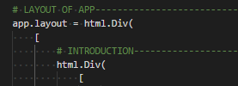
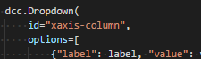
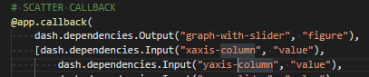
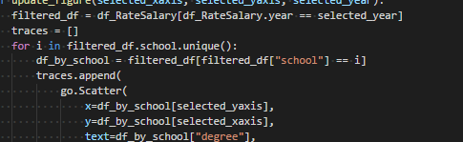
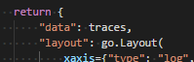
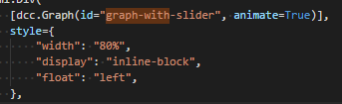
GENERAL PLOTTING PROCESS USING DASH PLOTLY
import dash import dash_core_components as dcc import dash_html_components as html import plotly.graph_objs as go
In the app.layout = html.Div([]), to create interactive elements for charts, e.g. use dcc.Dropdown() and specify an id
Create a callback to make the plot related to the interactive element, taking in input and putting out output
Get dataframe/array for x and/or y axis values using dataframes retrieved from Mongo
Create array of Plot elements using e.g. go.Scatter and x/yaxis values
Return array of plot elements as “data” and specify go.Layout
Plot dcc.Graph() with output id of callback in app.layout; add style to html.Div if neccessary

Slide 17
INSIGHTS FROM GRAPHS
General Insights from the 7 Graphs

Slide 18
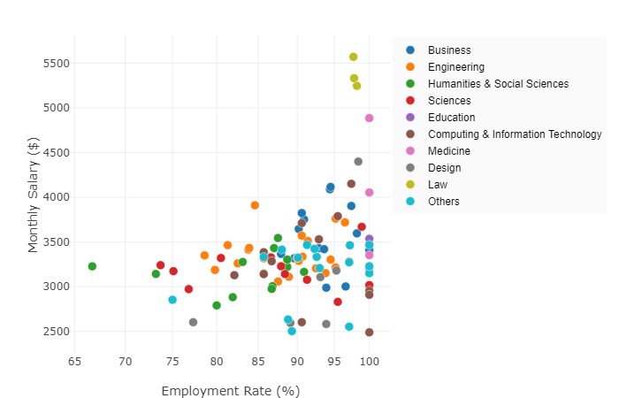
SCATTERPLOT OF Monthly Salary VS Employment Rate
Will your salary change with the fluctuations in demand for your industry?

Slide 19
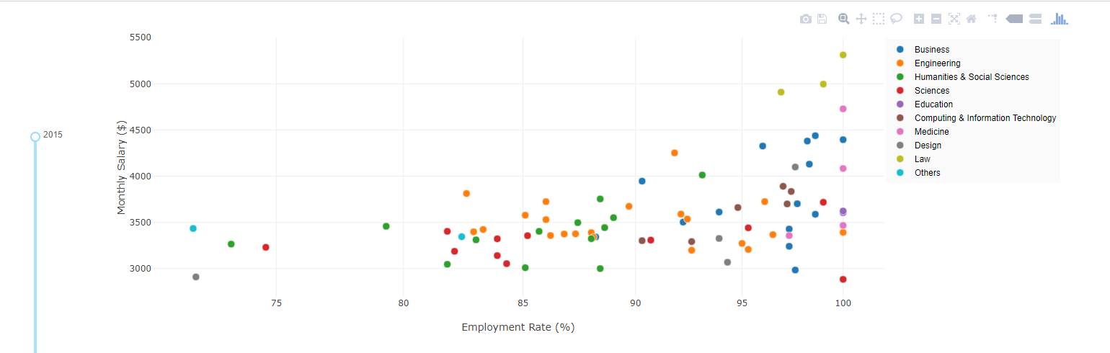
Chart plotted to discover job stability of the industries, to find out if salary is affected by changes in employment rate
At first glance, the scatterplot appears to show a general positive correlation between salary and employment rate, with a few outliers.
However, there seems to be more scatter points for Engineering, Humanities and Business, suggesting a larger data size for more accuracy in analysis. Hence, we will compare them with Computing and IT in more detail.

Slide 20
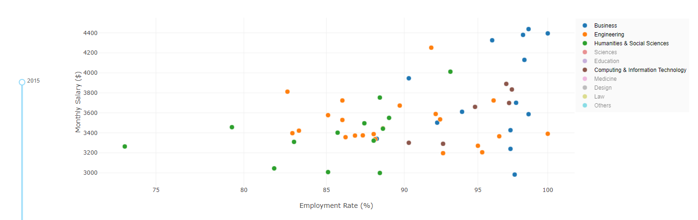
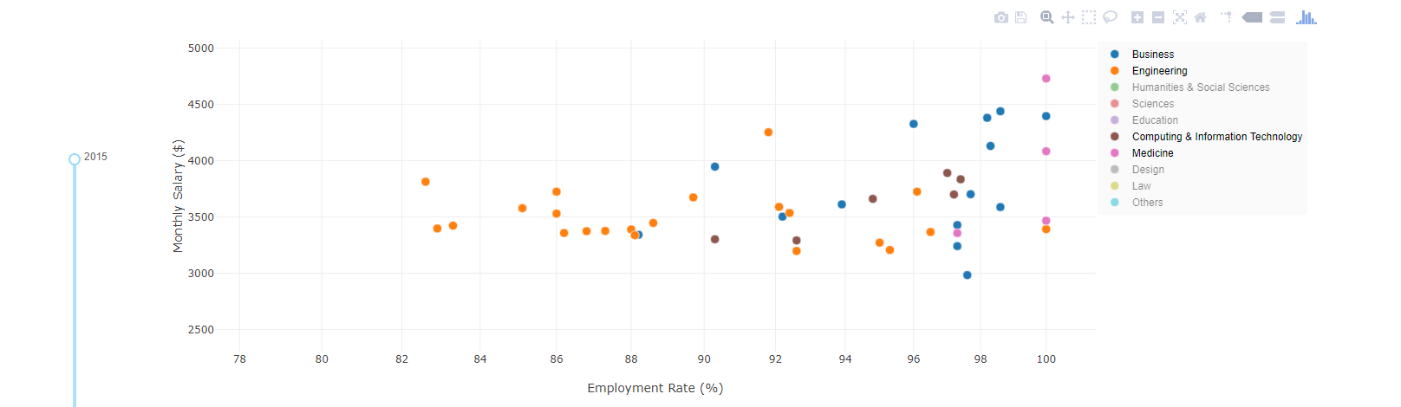
Upon closer analysis, there seems to be little to no correlation between salary and employment rate of the industries. Values are spread evenly through the scatterplot for each industry
However it is found that for Humanities and Social Sciences, values are more clustered at the lower end of salaries ($3K-$4K) and employment rate (70%-90%). Showing a lack of demand for such jobs.
There are more data points for Engineering and Business, and a higher clustering of data points in the higher end of salary($4.2K-$4.4K) and employment rate (95%-100%), showing a larger demand of such industries.

Slide 21
With business falling in a higher employment rate range (90%-100%), than Engineering (80%-100%)
Computing and Information Technology seems to be less in demand than business and engineering, with fewer data points, however, employment rate and salary of this Industry is comparable to them, falling in the higher end of employment rates (90%-95%), and in the mid-range of salaries ($3.2K-$4K)

Slide 22
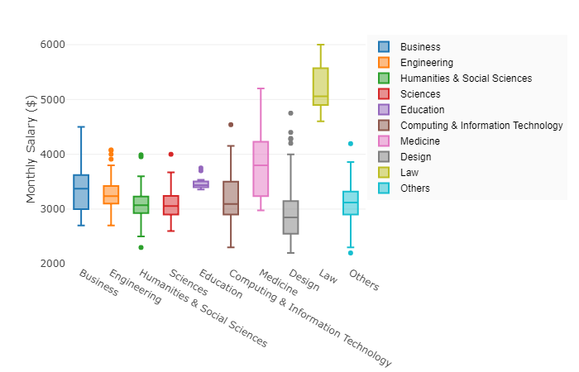
BOXPLOT of Monthly Salary for each industry
Find out the range of monthly wages for jobs in each industry, from the lowest to the most common, and the upper quartile.
Compare the industries, and consider how much you'll be aiming to earn.

Slide 23
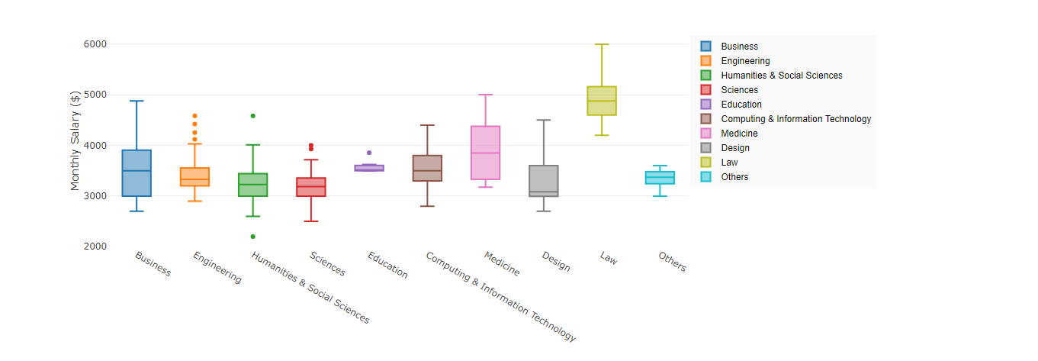
Education and Other industries have the smallest spreads and little outliers, showing that the range in salaries for these jobs are smaller, and they are less in demand compared to other industries.
Law, Business and Medicine have the highest medians and high spreads with large inner quartile ranges and whiskers (for the former two). This suggests that the amount of job opportunities for these Industries are higher, and the demand for professionals in these fields are high.
Surprisingly, Computing & Information Technology has similar medians and spreads as Medicine and Business. Students might find it more cost-worthy to join IT instead of medicine, given the expensive tuition fees of the latter; and it might be less competitive than business courses as well.

Slide 24
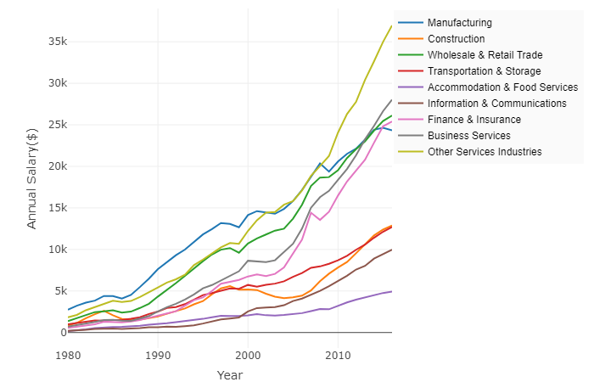
LINE CHART OF ANNUAL SALARY PER YEAR FOR EACH INDUSTRY
View how annual compensations for jobs vary by industry;
and how each industry's employee compensation has grown, and is expected to grow with time.

Slide 25
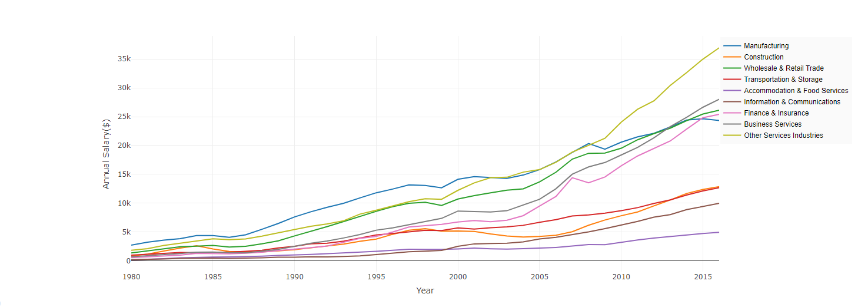
Chart plotted to discover job stability of the industries, to find out if salary is affected by changes in employment rate
The chart shows that there has been a general increasing trend of annual salaries for all industries from 1980 to 2016.
This wage raise is likely due to inflation over the years, and it likely predicts a continual wage increase from 2016 to the current and future years, as inflation increases.
Finance and insurance showed a spike in salary in 2008, which correlates with the financial turmoil that occurred in 2008, where financial insurance played an important supporting role.
Notes:
Read more at https://www.channelnewsasia.com/news/singapore/singapore-workers-pay-increase-2018-survey-eca-9404680

Slide 26
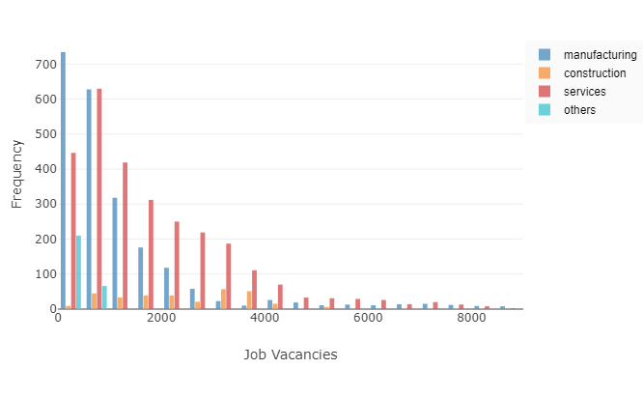
HISTOGRAM OF JOB VACANCIES
Is there a little bit of variability in your industry's job vacancies throughout the years, or a lot?

Slide 27
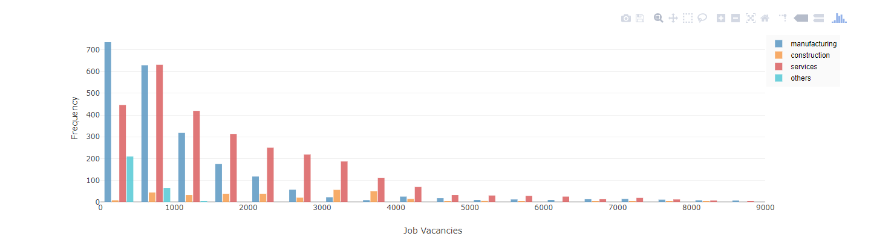
Chart plotted to discover the distribution of Job Vacancies in the economy for all industry sectors.
It is immediately observed that the Construction and Others industries have the lowest number of job vacancies, with the lowest frequencies within the 0 to 1000 bins for others, and the 0 to 4000 bins for construction.
Manufacturing and Services have the largest number of job vacancies, and given the larger data size for more accuracy, and the focus on IT within the services sector, I shall compare them in more detail.

Slide 28
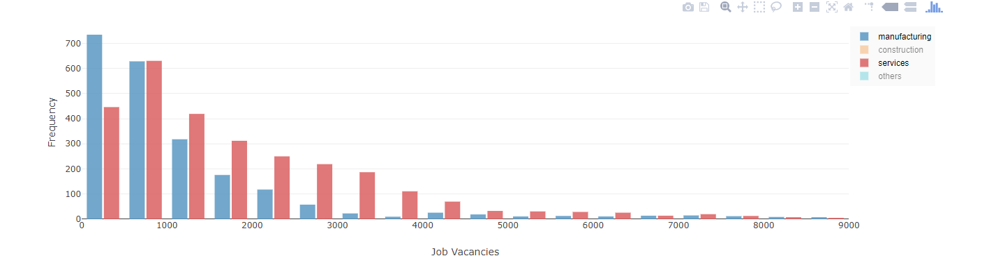
Manufacturing and Services both have right-skewed distributions, with long tails on the right, which shows that their means are less than their medians, and that they have large standard deviations, and hence, a wide spread of data.
This possibly suggests that the number of job vacancies throughout the years has varied significantly, and the industries are not necessarily stable.
This chart also shows that the number of job vacancies for Manufacturing and Services usually fall within the 0 to 3000 bins, with services having a greater number of Job Vacancies overall, and hence a larger demand for workers in that industry.

Slide 29
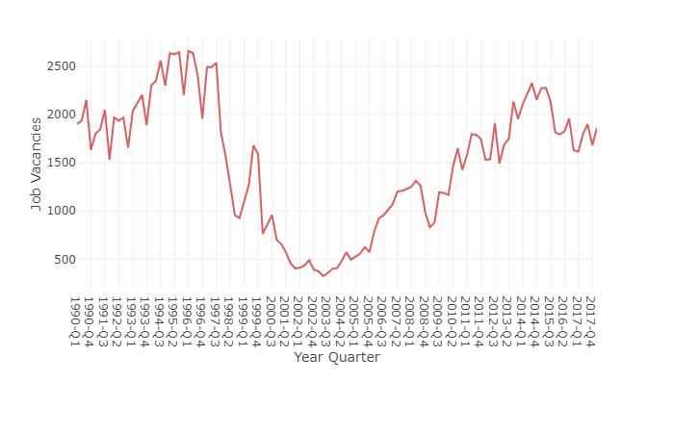
LINE CHART OF JOB VACANCIES PER YEAR
View the job vacancies that open for each industry’s occupations throughout the years, and the trend that they are headed towards.

Slide 30
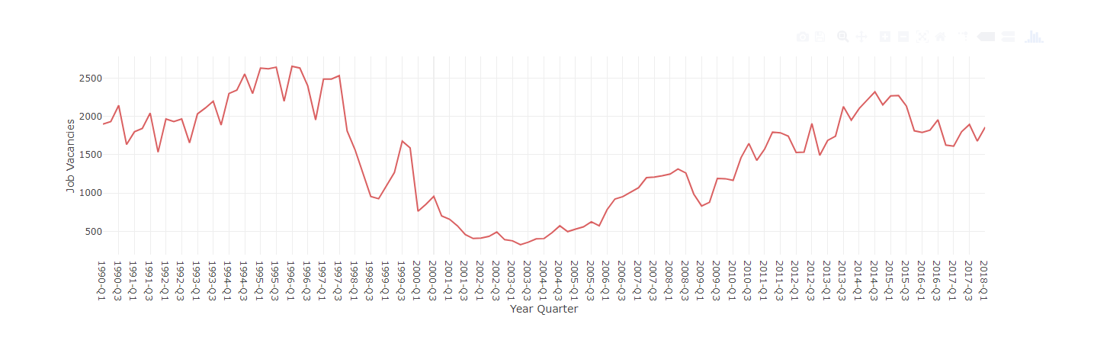
The chart shows a peak in job vacancies in 1996 and a low in 2003, likely due to the changes in the market demand for workers and changes in overall productivity in the labour force.
There has been a drop in Job Vacancies in 2017, which can be attributed to the drop in foreign employment caused by a decrease in work permit holders in construction and marine. This led to the economy hiring fewer workers for 2017.
This chart shows the upward trend of job vacancies from the first quarter of 2018 onwards, and it is projected to increase given the expanding share of services in the economy.
Chart plotted as a continuation of the previous plot, appearing on hover, to find out the trends of job vacancies over the years, and find out projected trends.

Slide 31
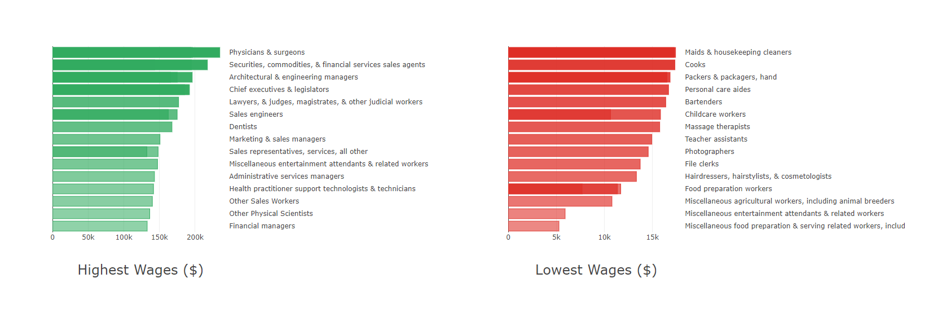
BAR CHARTs OF IT OCCUPATIONS WITH THE HIGHEST AND LOWEST WAGES
To help IT student make their decisions on whether to remain in the IT field, these charts let them consider the highest and lowest paying jobs, to give them a feel of what the field has to offer

Slide 32
This chart was plotted with the objective of allowing students to find out the best and worst paid jobs in the field of IT, if they were still considering continuing into it in the end.
This would give them a general idea of the highest and lowest wages to potentially give them choices to aim for or avoid, and also expose them to the job options they have when they take the Computer and Information Sciences and Support Services Course.
The maximum wages in the field of IT is $250K with Physicians, Sales agents and Architectural & Engineering managers coming in with the highest pay, all jobs requiring higher education.
Lowest wages go to jobs more on the manual labour side, or to jobs with lower qualifications, such as food servers, entertainment workers, and animal breeders.

Slide 33
Given the plotted example of the wages of different occupations, with qualifications generally known. It is suggested that students do take up higher qualification studies, regardless of the industry field, in order to get better paying jobs.

Slide 34
THANK YOU
fin

